Slide 1
Steganography
CAPSTONE PROJECT
Presented By: Vivek Gokhale
Student Name : Vivek Gokhale
College Name & Department : Pandit Deendayal Energy University

Slide 2
OUTLINE
Problem Statement
Technology used
Wow factor
End users
Result
Conclusion
Git-hub Link
Future scope

Slide 3
Problem Statement
With the rise of digital communication, protecting sensitive information is crucial. Traditional encryption methods can raise suspicion if intercepted. Steganography provides a way to hide secret messages within ordinary images, making the information invisible to outsiders. This project, "Stego Kavach," aims to develop a system that securely hides and retrieves messages from images using a passcode. It ensures data privacy while allowing safe and covert communication.

Slide 4
Technology used
Front end : HTML, JavaScript
Backend : Django, OpenCV

Slide 5
Wow factors
Passcode-Based Access: Only users with the correct passcode can hide or retrieve the hidden message, adding an extra layer of security.
Dual Encryption & Steganography: Combines encryption with image steganography for enhanced data protection.
User-Friendly Interface: Provides a simple and intuitive UI for easy encoding and decoding of messages.
High Security & Privacy: Ensures that hidden messages remain undetectable to unauthorized users.
Customizable & Scalable: Can be adapted for various use cases like secure communication, data protection, and confidential file sharing.

Slide 6
End users
Journalists & Whistleblowers: To securely share sensitive information without attracting attention.
Government & Defense Agencies: For confidential communication and secure data transfer.
Corporate Sector: To protect intellectual property and private business information.
Individuals: For personal privacy and secure sharing of sensitive messages.
Researchers & Cybersecurity Experts: For testing and enhancing data protection techniques.

Slide 7
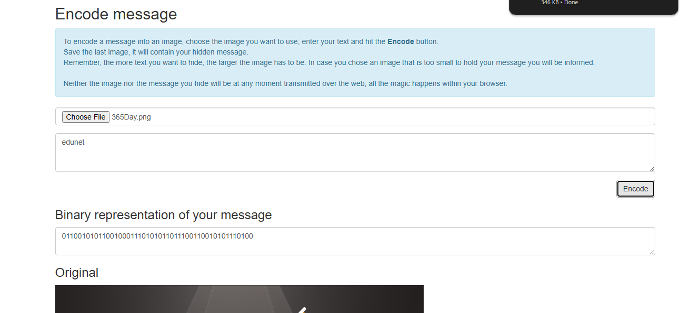
Results

Slide 8
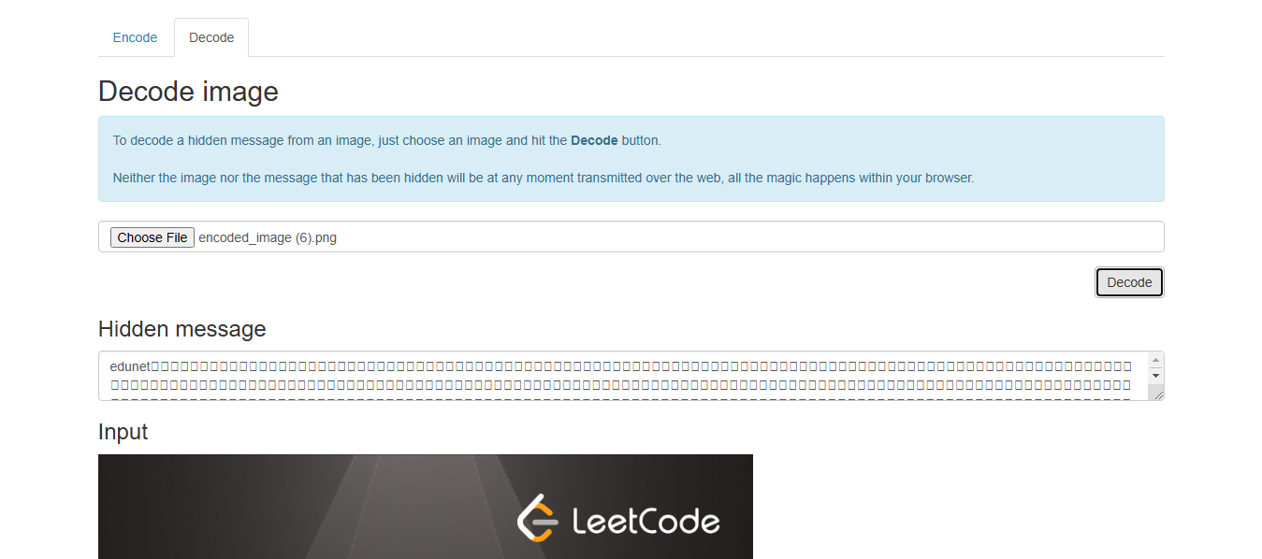
REsult

Slide 9
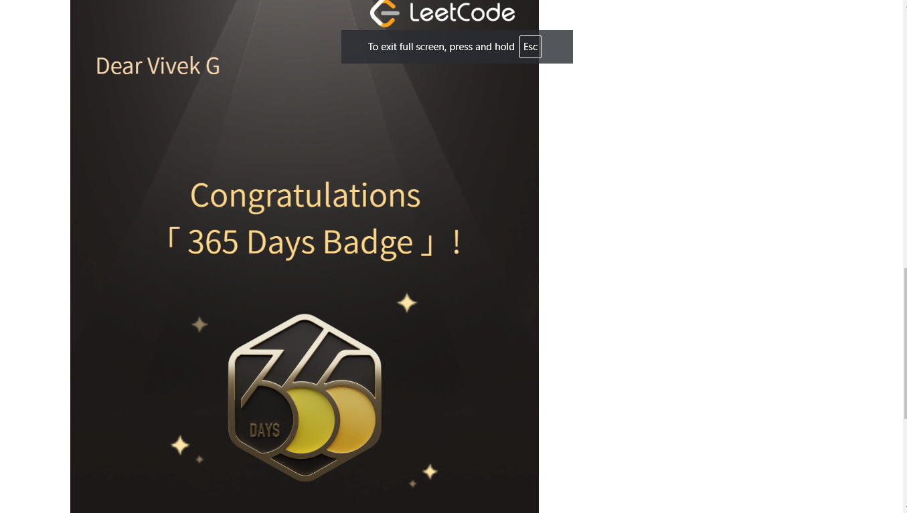
result

Slide 10
Conclusion
Stego Kavach provides a robust and user-friendly solution for secure communication through image steganography. By combining encryption with passcode-based access, it ensures sensitive messages remain hidden and accessible only to authorized users, enhancing privacy and data protection.

Slide 11
GitHub Link
https://github.com/Vivek-Gokhale/StegoKavach.git

Slide 12
THANK YOU

